Slide 1
Nuclear Medicine

Slide 2
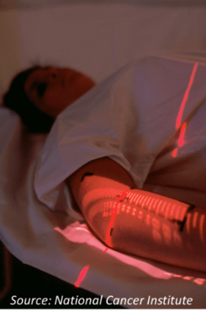
In this Smart Lesson you will learn to:
Recall some of the ways in which radioactivity can be used in nuclear medicine.
List some of the isotopes used in nuclear medicine.

Slide 3
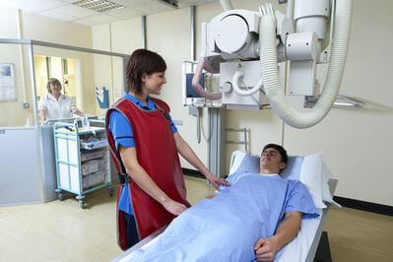
Radioactive elements are used in medicine to detect and treat medical problems.
Elements which emit gamma radiation (γ) are used to detect problems, while elements which emit beta radiation (β−) are used to treat them.

Slide 4
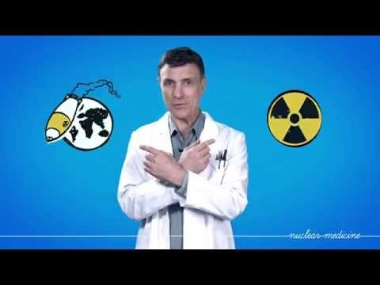

Slide 5
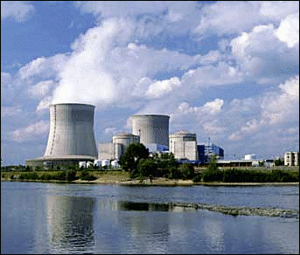
Radioactive elements for medical use are made in Australia.
This is because radioactive elements often have short half lives. This means that they can't be imported from other countries, so we need to make our own.
The OPAL reactor in Sydney is used to make most of the elements Australia needs for medical purposes.

Slide 6
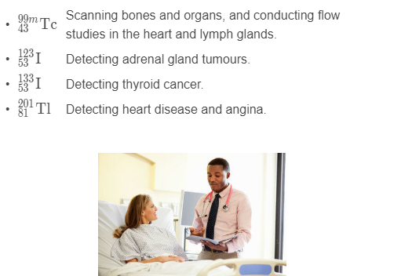
Here are some of the main gamma ray emitting isotopes and their medical uses.

Slide 7
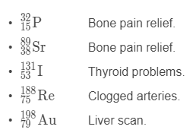
Isotopes for medical treatment.
Radioactive isotopes which release electrons when they decay (β− decay) are used for medical treatment.

